Slide 1
Troop 344/9344 Pemberville, OH
Fishing Merit Badge

Slide 2
Requirements
Do the following:
Explain to your counselor the most likely hazards you may encounter while participating in fishing activities, and what you should do to anticipate, help prevent, mitigate, and respond to these hazards.
Discuss the prevention of and treatment for the following health concerns that could occur while fishing, including cuts, scratches, puncture wounds, insect bites, hypothermia, dehydration, heat exhaustion, heatstroke, and sunburn.
Explain how to remove a hook that has lodged in your arm.
Name and explain five safety practices you should always follow while fishing.
Discuss the differences between two types of fishing outfits. Point out and identify the parts of several types of rods and reels. Explain how and when each would be used. Review with your counselor how to care for this equipment.
Demonstrate the proper use of two different types of fishing equipment.
Demonstrate how to tie the following knots: improved clinch knot, Palomar knot, uni knot, uni to uni knot, and arbor knot. Explain how and when each knot is used.

Slide 3
Requirements
Name and identify five basic artificial lures and five natural baits and explain how to fish with them. Explain why bait fish are not to be released.
Do the following:
Explain the importance of practicing Leave No Trace techniques. Discuss the positive effects of Leave No Trace on fishing resources.
Discuss the meaning and importance of catch and release. Describe how to properly release a fish safely to the water.
Obtain and review a copy of the regulations affecting game fishing where you live. Explain why they were adopted and what you accomplish by following them.
Explain what good outdoor sportsmanlike behavior is and how it relates to anglers. Tell how the Outdoor Code of the Boy Scouts of America relates to a fishing sports enthusiast, including the aspects of littering, trespassing, courteous behavior, and obeying fishing regulations.
Catch at least one fish and identify it.
If regulations and health concerns permit, clean and cook a fish you have caught. Otherwise, acquire a fish and cook it. (You do not need to eat your fish.)

Slide 4
Requirement 1a & 1d
Do the following:
Explain to your counselor the most likely hazards you may encounter while participating in fishing activities, and what you should do to anticipate, help prevent, mitigate, and respond to these hazards.
Name and explain five safety practices you should always follow while fishing.

Slide 5
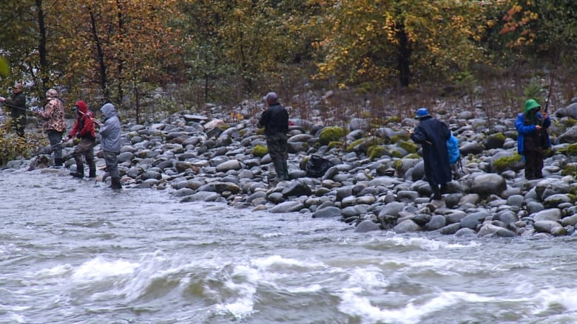
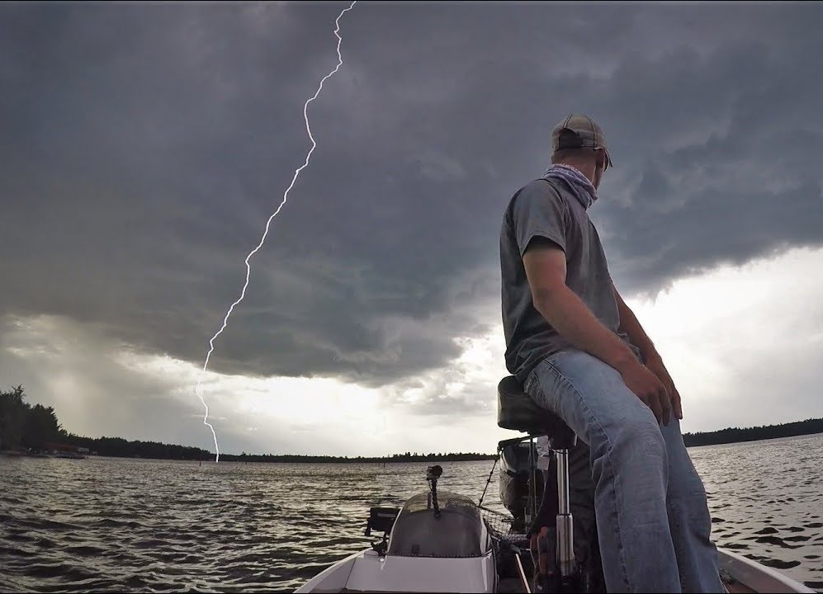
Hazards of Fishing
Drowning
Slipping, falling into the water or underwater holes
Being swept down river by flowing water
Lightning and storms.
Sunburn!
Dehydration and heat related injuries.
Insect bites and stings
Slipping or cutting yourself on sharp, rocky edges.
Cuts and puncture wounds from fishing equipment.
The farther out you go, the risks increase—so be prepared!

Slide 6
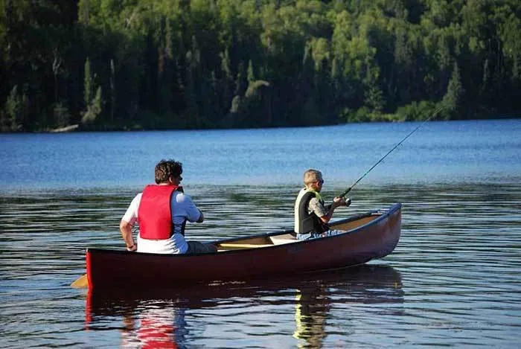
Keeping Safe while Fishing
Never go fishing alone – always fish with someone else and, ideally, with two other people.
Let somebody know the location of your fishing trip, who you are going with and an approximate time you will be back.
Wear a life jacket when fishing off rocks, ledges, a riverbank, wading, or a boat. A life jacket can save your life if you fall into the water, whether you are on a boat or near the water. It is extremely difficult to put on a life jacket when an emergency occurs or when you are in the water. It is safer to wear a life jacket at all times, before any emergency occurs.

Slide 7
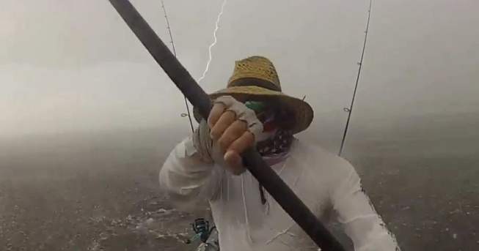
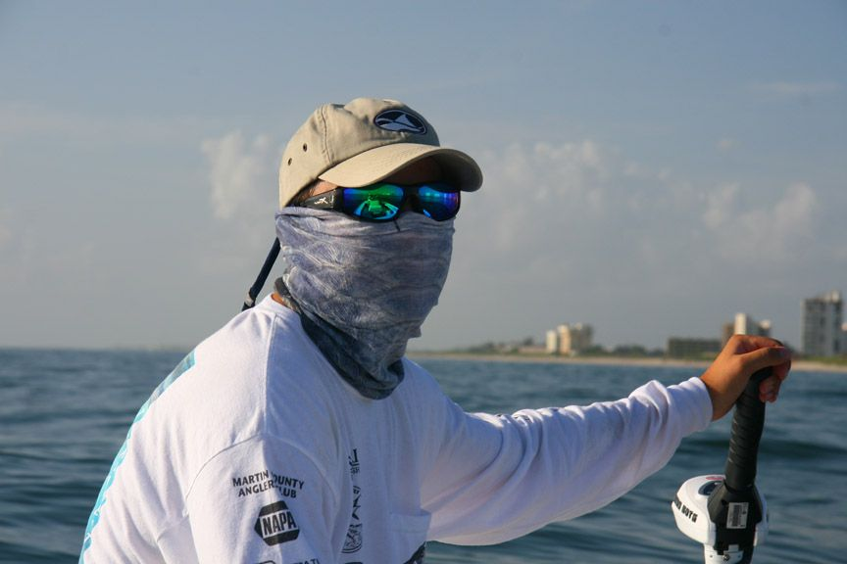
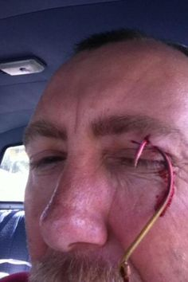
Keeping Safe while Fishing
Be aware of weather conditions and seek shelter during storms.
Wear non-slip shoes and take care to avoid slipping or cutting yourself on sharp, rocky edges.
Be SunSmart. Wear sun protective clothing, use SPF30+ (or higher) sunscreen and lip balm, wear an appropriate hat, seek shade where possible and wear sunglasses.
Take adequate drinking water.
Use an insect repellant that contains DEET.
Carry a first aid kit with you.
Stop fishing immediately if an injury occurs and seek prompt medical treatment.

Slide 8
Requirement 1b
Do the following:
Discuss the prevention of and treatment for the following health concerns that could occur while fishing, including cuts, scratches, puncture wounds, insect bites, hypothermia, dehydration, heat exhaustion, heatstroke, and sunburn.

Slide 9
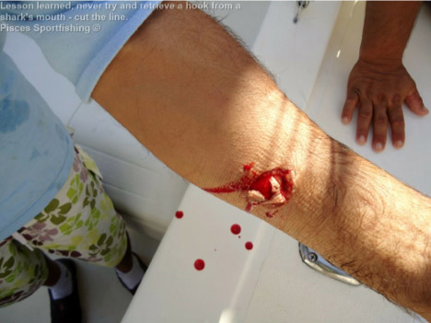
First Aid and Fishing
Cuts: Always wear latex gloves when applying first aid to a bleeding victim.
Treatment:
Clean the wound with an antibacterial and apply a bandage.
In almost all cases, applying "Direct Pressure" to the wound may stop bleeding. That is by pressing down upon the wound with your fingers or hand.
If a sterile dressing is available, it may be placed on the cut before pressing down, but if the bleeding is serious, DO NOT WAIT for the sterile material. It is better to have a live victim with a few germs than a sterile wound on a dead patient.

Slide 10
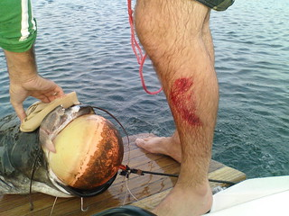
First Aid and Fishing
Scratches: Scratches are very common injuries that are usually caused by animals.
Treatment:
First, because scratches can easily become infected, you should clean the area thoroughly and remove any dirt and debris. Cover wound with gauze.
Do not scrub vigorously, as this can cause more tissue damage.

Slide 11
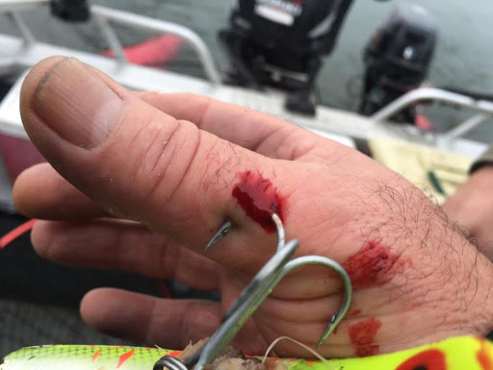
First Aid and Fishing
Puncture Wound: A puncture wound doesn't usually cause excessive bleeding. Often the wound seems to close almost instantly. But these features don't mean treatment isn't necessary.
Treatment:
Clean and cover the wound. Change the dressing regularly. Watch for infection.

Slide 12
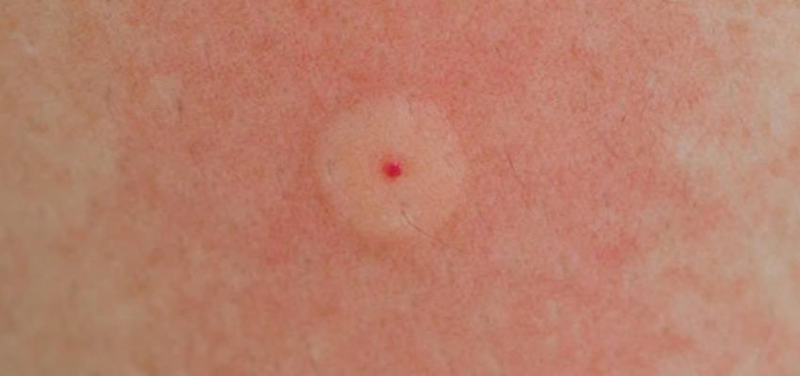
First Aid and Fishing
Stings: A sting or bite injects venom composed of proteins and other substances that may trigger an allergic reaction in the victim.
Symptoms:
Most bites and stings result in pain, swelling, redness, and itching to the affected area.
Severe reaction include hives, wheezing, shortness of breath, unconsciousness, and even death within 30 minutes.
Treatment:
If there is only redness and pain at the site of the bite, application of ice is adequate treatment. Clean the area with soap and water to remove contaminated particles left behind by some insects (such as mosquitoes). Refrain from scratching because this may cause the skin to break down and an infection to form.

Slide 13
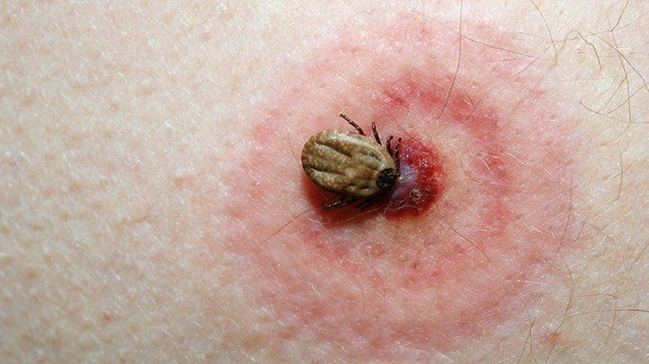
First Aid and Fishing
Tick bites: Second only to mosquitoes as vectors (carriers) of human disease.
Symptoms:
Redness, itching, and swelling
Lyme’s Disease: The hallmark target lesion, a red circular rash with a pale center, occurs at the site of the bite within 2-20 days after the bite in 60-80% of cases. The rash may be accompanied by fatigue, headache, joint aches, and other flulike symptoms.
Prevention/Treatment: Wear long-sleeved shirts, long pants cinched at the ankle or tucked into the boots or socks. If attached, using rounded tweezers, grasp the tick as close as possible to the skin surface, and then pull with slow steady pressure in a direction away from the skin.

Slide 14
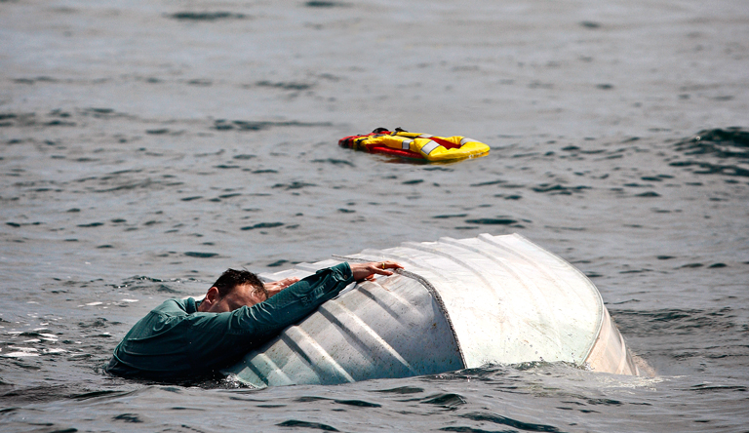
First Aid and Fishing
Hypothermia: Over-exposure to colder temperatures over time that result in a drop in body core temperature.
Symptoms:
Initial mental status changes in response to cold may be subtle and include hunger and nausea.
This will progress to apathy, confusion, slurred speech, and loss of coordination.
Many times a person will just lie down, fall asleep, and die.
Treatment: Removing them from the elements that caused the condition. Seek a dry, warm place away from the wind.

Slide 15
First Aid and Fishing
Dehydration: Occurs when the loss of body fluids, mostly water, exceeds the amount that is taken in.
Symptoms:
Weakness and/or dizziness
Confusion and/or sluggishness, even fainting
Inability to sweat
Decreased urine output. If urine is concentrated and deeply yellow or amber, you may be dehydrated.
Treatment: Sip small amounts of water or carbohydrate/electrolyte-containing drinks. Treat for heat Increased thirst with dry mouth and swollen tongue

Slide 16
First Aid and Fishing
Heat exhaustion: This condition often occurs when people exercise (work or play) in a hot, humid place and body fluids are lost through sweating, causing the body to overheat.
Symptoms:
Often pale with cool, moist skin
Sweating profusely
Muscle cramps or pains
Feels faint or dizzy
May complain of headache, weakness, thirst, and nausea
Core temperature elevated—usually more than 100°F—and the pulse rate increased
Treatment: oral fluids and cool, shading

Slide 17
First Aid and Fishing
Heatstroke: This medical condition is life-threatening. The person's cooling system, which is controlled by the brain, stops working and the internal body temperature rises to the point where organ damage.
Symptoms:
Unconscious or has a markedly abnormal mental status (dizziness, confusion, hallucinations, or coma)
Flushed, hot, and dry skin (although it may be moist initially from previous sweating or from attempts to cool the person with water)
May have slightly elevated blood pressure at first that falls later
May be hyperventilating
Core temperature of 105°F or more
Treatment:
Ice packs/sheets, IV fluids, and medical evacuation

Slide 18
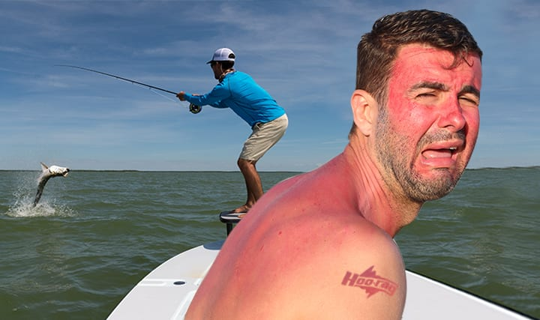
First Aid and Fishing
Sunburn: Excessive or prolonged exposure to the ultraviolet (UV) radiation of the sun. The time between 11 am and 2 pm contains the most powerful solar radiation exposure period.
Symptoms:
Sunburned skin is red and dry in exposed areas in a first-degree burn. Often, one may not realize that the skin is burned until ours later.
If exposure to the sun continues, second-degree burns may occur and blisters with clear fluid may form.
Treatment: Sun protection or appropriate coverings should be worn at all times, but especially during this time to decrease risk of sunburn.

Slide 19
Requirement 1c
Do the following:
Explain how to remove a hook that has lodged in your arm.

Slide 20
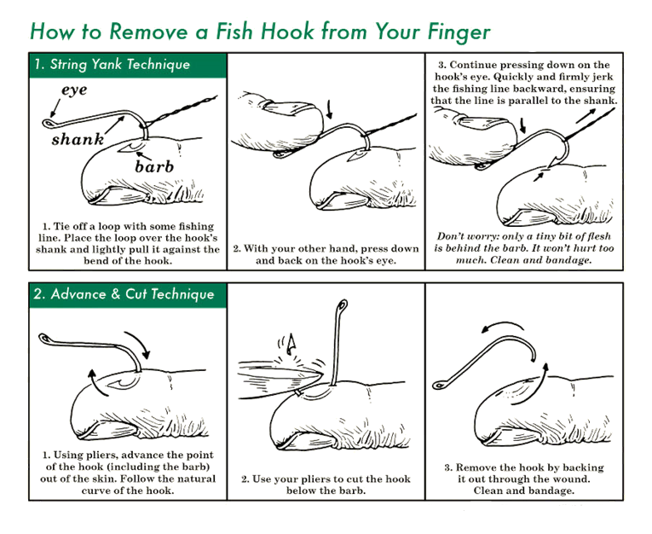

Slide 21
Requirement 2
Discuss the differences between two types of fishing outfits. Point out and identify the parts of several types of rods and reels. Explain how and when each would be used. Review with your counselor how to care for this equipment.

Slide 22
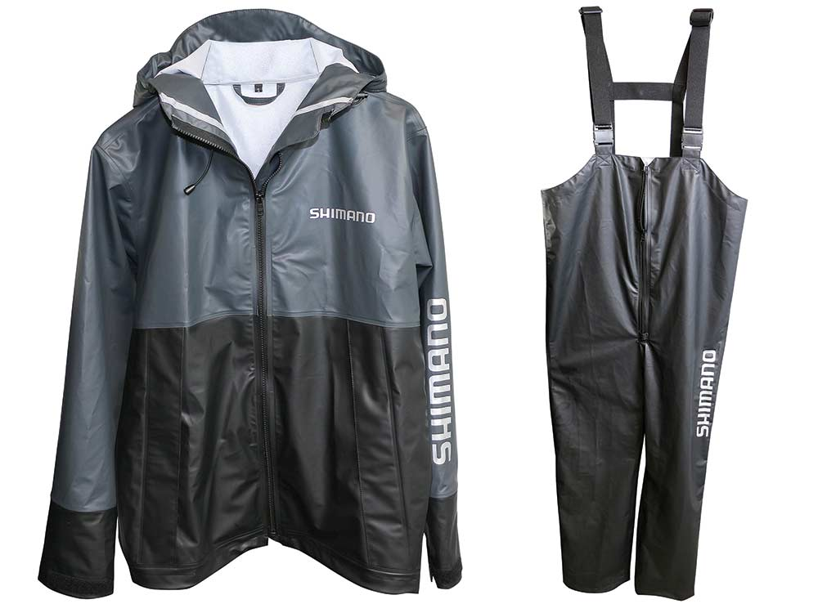
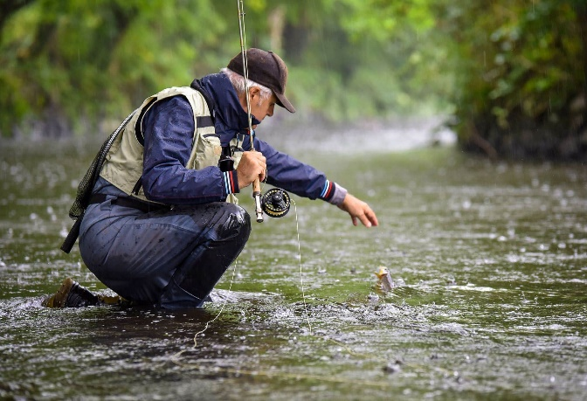
Fishing Outfits
Rain Gear. Fishermen discover quickly that rain often accompanies some of the best fishing. The best outfits are matching rain parkas and pants in earth tones, made of waterproof and windproof fabric. Lightweight rain gear can be rolled into a small package and stowed in the pocket of a jacket or pack. Ponchos will do a good job of shedding rain, but they provide poor coverage on windy days and make casting difficult.

Slide 23
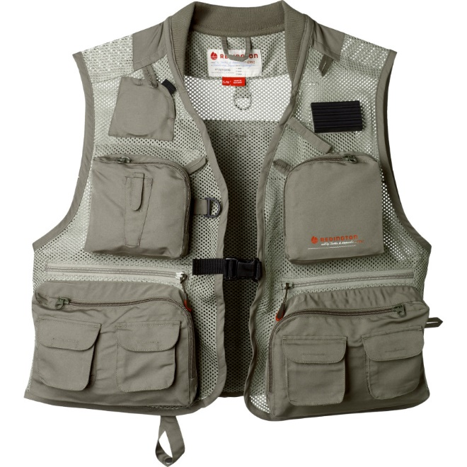
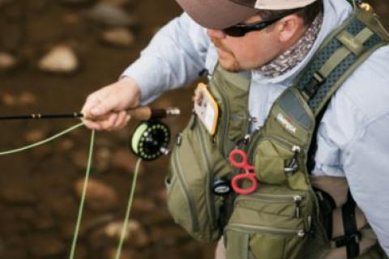
Fishing Outfits
Fishing Vest. This handy many-pocket garment is useful for carrying hooks, leaders, flies, lures, bait, and other items. The fishing vest helps keep an angler’s hands free. While it is not a necessity, it is convenient for the angler who can afford one. When shopping for a fishing vest, think about the weather conditions you will encounter. Be aware of the bulk your filled pockets may create. You might want to consider a vest that comes with a personal flotation device built in—it will inflate if you pull a cord.

Slide 24
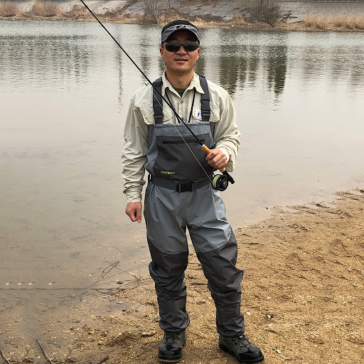
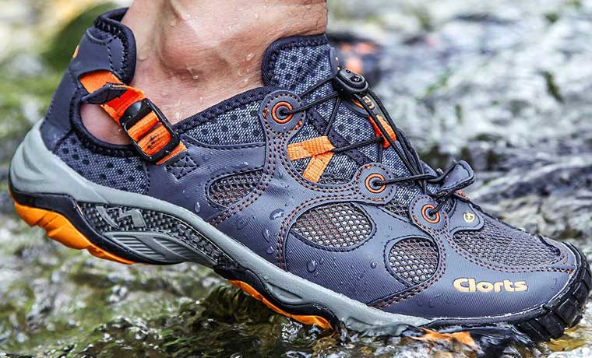
Fishing Outfits
Footgear. Sneakers or leather boots are suitable footwear for boat fishermen, but the wading angler needs to pay careful attention to the feet. In cold weather, or in icy trout streams or surf, hip boots—or better yet, chest-high waders—help keep the legs dry. In warm streams during summer, it may be tempting to wade barefoot, but wading with bare feet invites injuries from broken glass, rusty nails, or even a spiny sea urchin. To avoid foot and leg injuries, wear a pair of old shoes and old jeans.

Slide 25
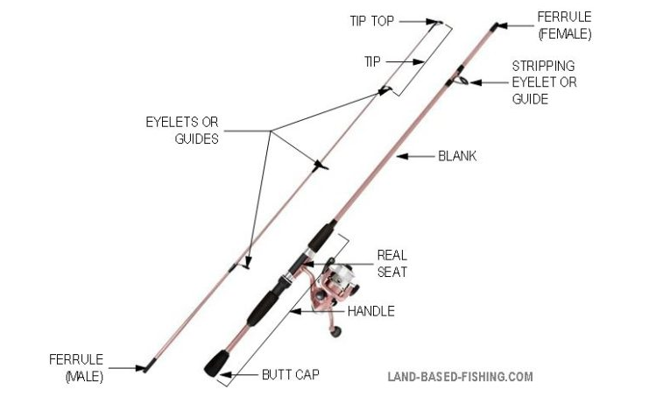
Parts of a Fishing Rod
Blanks are also called barrels. These are the main sections of each type of fishing rod where everything else is attached to. They come in two or three sections and slotted together.
Butt or Cap is at the very end of the rod. It can be made of plastic, cork or rubber. The butt end cap protects the rod from damage.

Slide 26
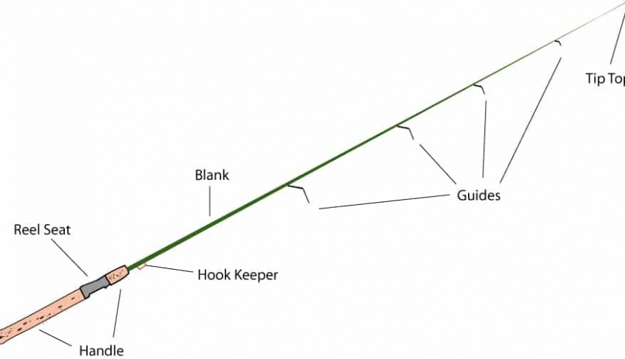
Parts of a Fishing Rod
Handle is also called the grip. Made of cork, wood, or of PVC.
Reel Seat is where the reel is attached to the rod.
Hook Keeper is a simple ring that is attached near the handle to slip your hook through, so you can move round without your line swinging free and the hook catching on obstacles.

Slide 27
Parts of a Fishing Rod
Ferrules are the thin metal or plastic joints that fit the sections of the rod together. Ferrules are delicate are easy to damage.
Eyes are sometimes called guides. they are what you thread the line through.
Windings is thread that attaches the eyes to the barrel or blank.

Slide 28
Parts of a Fishing Rod
Rod End or Tip is the very end of the rod, which is sharply tapered and delicate, compared with the rest of the rod.
Tiptop or end-ring includes the eye at the very tip of the rod.

Slide 29
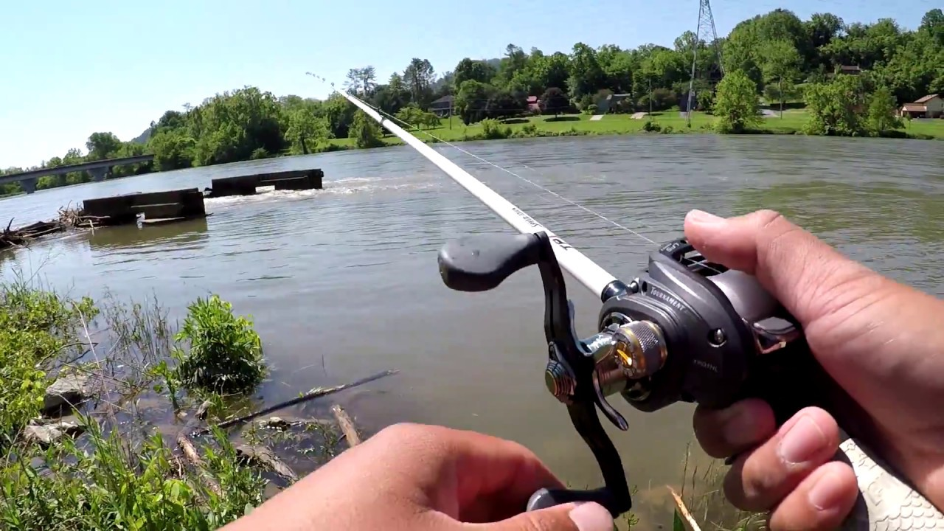
Types of Rods
A baitcasting rod is equipped with a reel seat that positions a baitcast reel above the rod and all the rod guides face upward.
When fighting a fish on a casting rod the rod bends over with the guides facing up so the force of the fish pushes the line down on the eyelets and the rod blank.

Slide 30
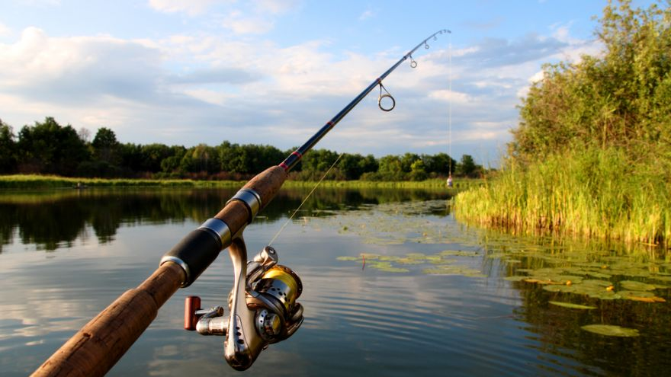
Types of Rods
A spinning rod holds the spinning reel under the rod with the rod guides facing downward.
When you are fighting a fish, the force of the line pressed against the eyelet is pushing away from the rod blank

Slide 31
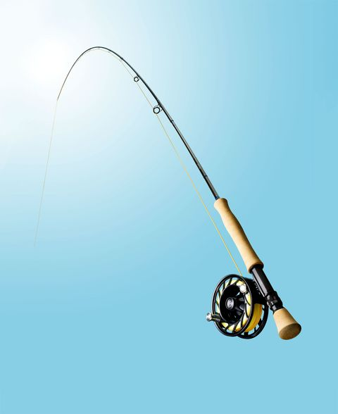
Types of Rods
Fly rods are fishing rods built specifically for fly-fishing. The reel is mounted below the handle to create balance in the rod when it's used.
A normal fishing rod (spinning and casting rods) uses a heavy lure to pull a light line to its target location. A fly rod does the exact opposite as a heavy line pulls the lightweight fly to its desired target.

Slide 32
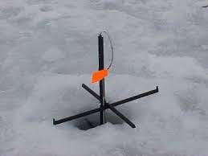
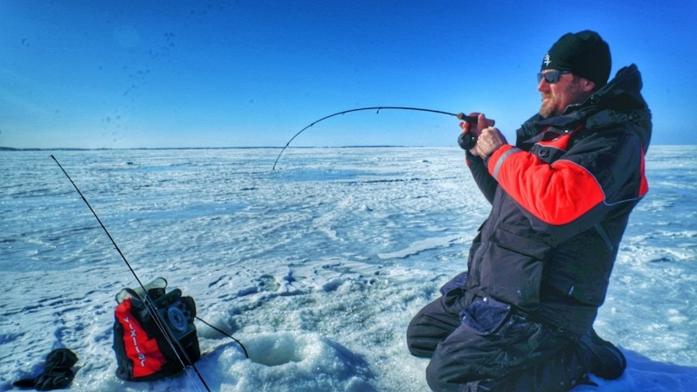
Types of Rods
The ice fishing pole is shorter than one you'd use during the summer because you can't cast into a small hole.
There are two basic types of ice fishing poles:
A tip-up pole has a long stick with a reel and a trigger device that hangs into the hole. A flag is attached to a spring at the top of the stick. When a fish bites, the spring activates and the flag goes up in the air to let you know you have a catch.
A jigging rod looks like a traditional fishing pole, only it's lighter and shorter -- only about 2 feet long. You move these poles up and down every few seconds to bounce the bait and get the fish's attention.

Slide 33
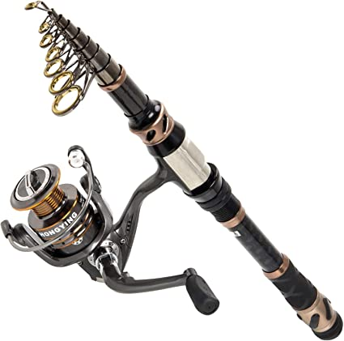
Types of Rods
Telescopic fishing rods are simply fishing rods that fold into themselves allowing for greater portability.
Since their collapsed sizes are only between 18- and 26-inches, they can fit almost anywhere.

Slide 34
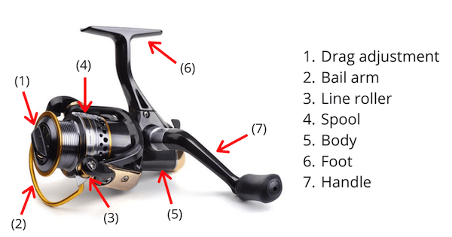
Parts of a Fishing Reel
Drag Adjustment Knob is a button or set of buttons that can be pressed by the finger allowing the angler to increase or decrease the amount of friction, or drag, on a line.
Bail Arm is designed to help move the line on and off the spool. It ensures the line cannot run freely off the spool as long as the bail arm is set down.

Slide 35
Parts of a Fishing Reel
Line Roller is the contact point of the line as it is reeled in from a cast.
Spool is the main part of the reel that holds the line.
Body is the reel’s central component and the focal point that holds all the features together.

Slide 36
Parts of a Fishing Reel
Foot - is the bridging point between the rod and the reel.
Handle - The reel handle is one of the most important components of a spinning reel and is rotated by the hand to bring (retrieve) the line back to the rod after the cast.

Slide 37
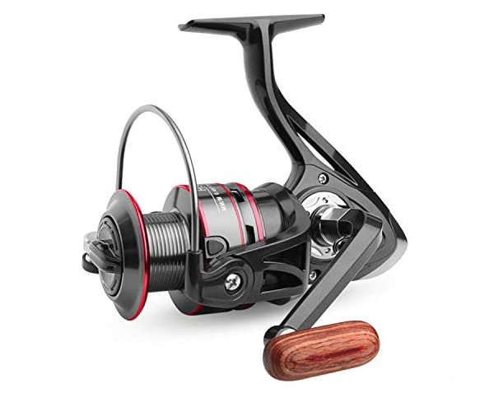
Types of Reels
Spinning reels are an easy-to-use open-face reel that can complement a lightweight setup. These reels are good for live, light baits and can be especially ideal for beginner fishermen.

Slide 38
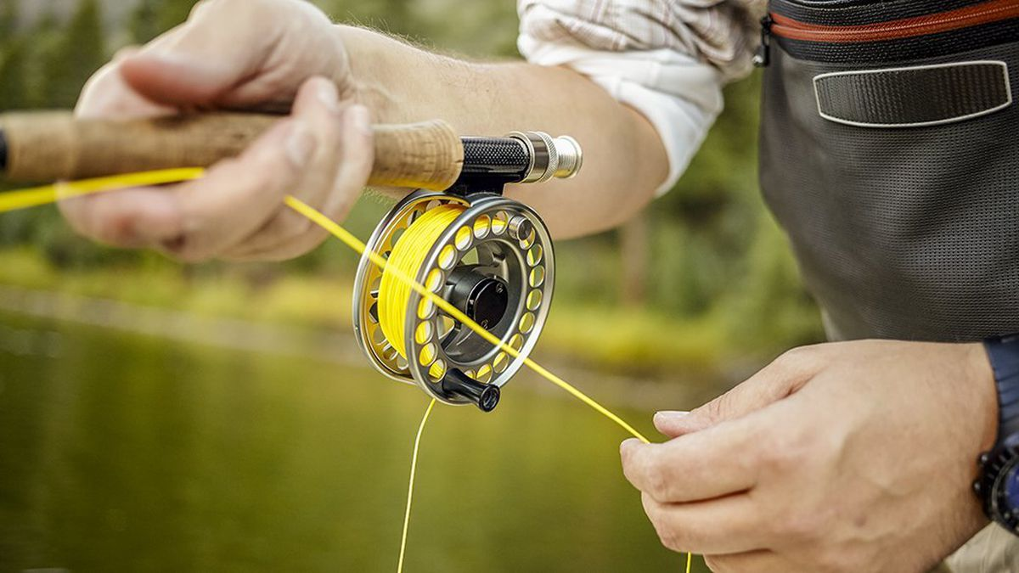
Types of Reels
Fly Reels hold the fly line and backing. Its braking system applies drag that puts pressure on the line and helps you control and bring in your fish.

Slide 39
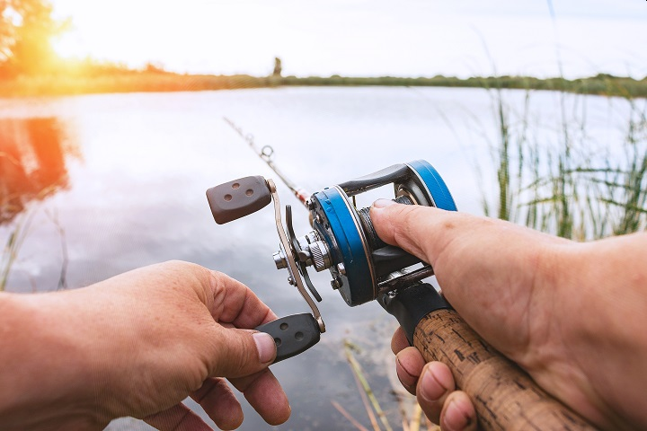
Requirement 2: Types of Reels
Baitcasting Reels have a revolving spool and sits on top of a casting rod with a trigger handle. This is exactly opposite to a spinning reel, which sits underneath a spinning rod and with the line guides facing down.

Slide 40
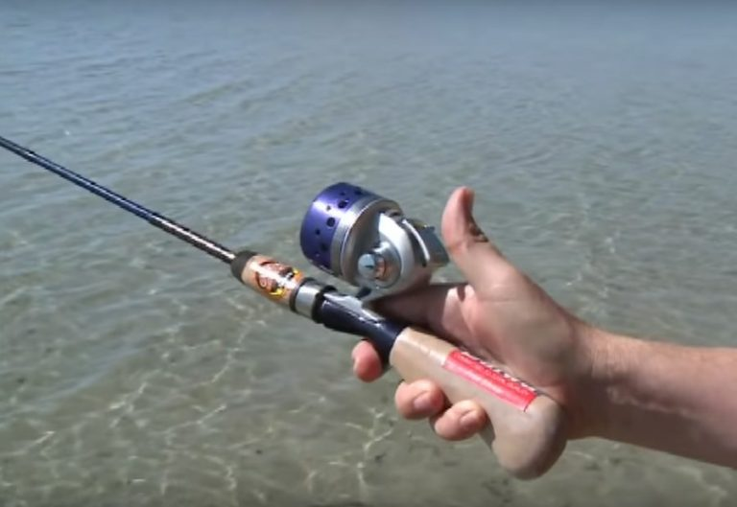
Requirement 2: Types of Reels
Spincast Reel are essentially spinning reels that are fitted with a plastic cover. The line emerges from a small hole at the front of the reel.

Slide 41
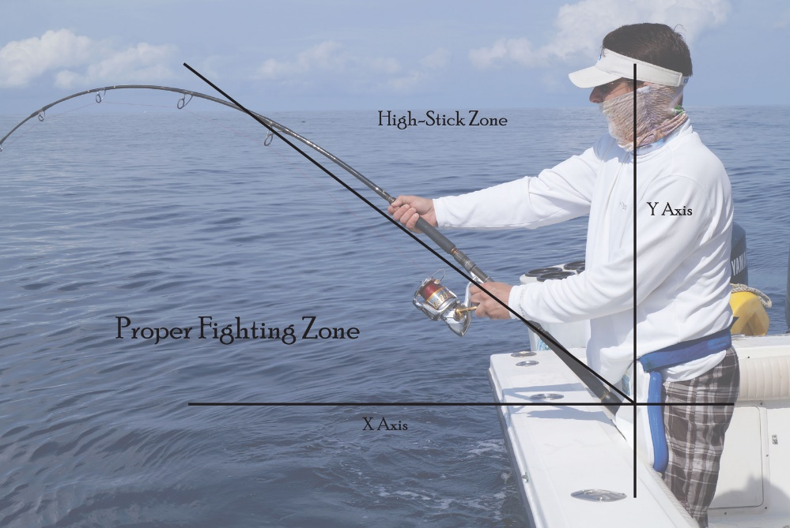
Care of Rods
General Care
Do not hang lures or hooks from the guides. This will scratch the surface of the guides and negatively affect your casting. Use the hook-keeper.
Do not let your lures bang the tip top by reeling in them in all the way.
Don’t strike the rod against hard surfaces.
Do not “high-stick.” This refers to over-flexing the rod and creating excess pressure on the tip top. When fighting a fish do not lift the rod past 45 degrees.

Slide 42
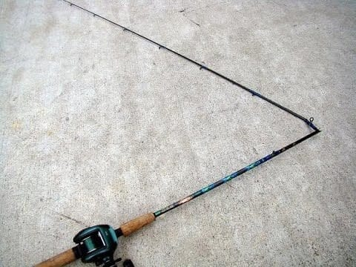
Care of Rods
Transport
Place your rod in your car or truck so that the rod is not banging against another rod or hard surface, and so nothing heavy will fall on it, smash it or otherwise damage it.
In the Field
When there is sufficient space, carry the rod horizontally with the tip pointing behind you. This will keep you from digging the tip into the ground and breaking it off.
Never lay your rod flat on the ground; that’s like asking for it to be stepped on. Use a rod holder instead.
If you have to lean the rod on your car, make sure you do it away from any open car doors. Car doors and fishing rods don’t play well together and the car door always wins.

Slide 43
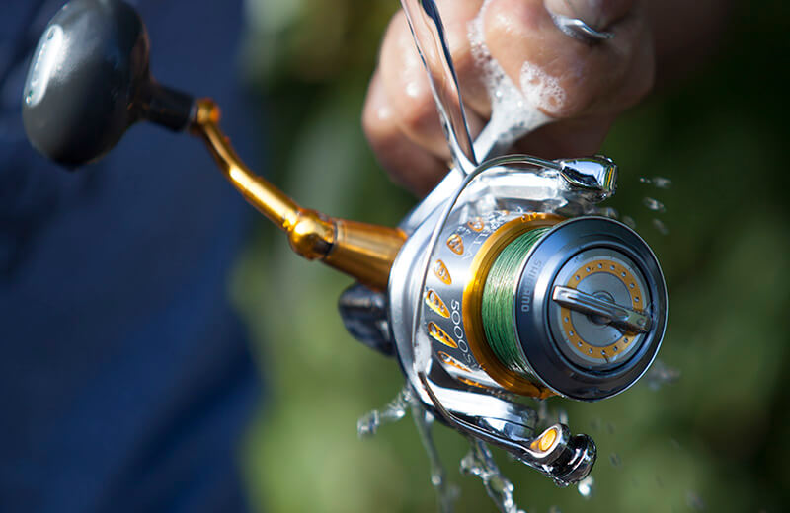
Cleaning Rods
Cleaning
Wash the entire rod with soap and fresh water. Rinse hot and let it dry thoroughly.
Ensure that the ferules are clean. Wipe down the male ferrules and apply a little grease or candle wax. Use a Q-tip to make sure the female ferules are free of dirt and grit.
Examine the guides for scratches. You can run a cotton ball or ladies nylon hose through the guides to see if it snags. If the guides are damaged replace them promptly.

Slide 44
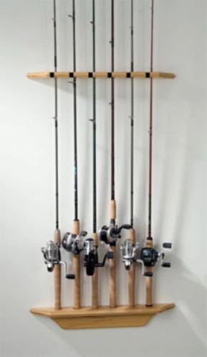
Storing Rods
Storage
Do not store your rod by leaning it on a wall or corner of a room. This will cause it to “set” (unwanted bend) over time.
Use a good rack system to keep your rod off the floor and out of harm’s way.

Slide 45
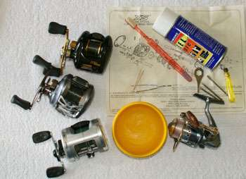
Care of Reels
Here are some simple ways you can maintain your fishing reel to prevent rust or corrosion.
Spool the line onto the reel so it is firmly packed and filled to within 1/8 inch of the rim.
Always use line within the pound-test range and type recommended for the reel.
After fishing, back off the drag; otherwise, it may become jerky or sticky the next time you use it.
Wash each reel after use, particularly when fished in dirty or salt water. Scrubbing with warm water and a small brush is the best way to remove salt and dirt.

Slide 46
Care of Reels
After a reel is dry, spray it with a DE moisturizing agent (such as WD-40 or CRC) to protect the metal parts.
To have a perfect reel for a long time, you need to provide oil and greases to several parts of your reel. It will make sure your reel remains better in the rough and sands. Also, if you are planning for saltwater fishing then, oil and grease can save your reel and rods from the salty water.
The parts that need oil are the handle, rotor, and line roller in spinning reels; and the level. Wind track and axle in casting reels. Add grease to the internal gearing and the level wind worm gear in casting reels. Fly reels require little greasing-only on the gears, on the pawls, and around the handle. Most reel manuals will give you additional details on your tackle.

Slide 47
Requirement 3
Demonstrate the proper use of two different types of fishing equipment.

Slide 48
How to Use a Spinning Rod
A spinning rod is made to hold the reel below as you fish. Also, these rods have fewer guides (the loops through which the line feeds) than casting ones, but the rods’ guides are larger. This lets the line play out more freely when casting. Most beginning anglers start with a spinning setup. It’s simpler to cast and less likely to get tangled up within the reel.
Spinning setups are also great for fishing with lightweight lures or bait, as you can get good distance on a cast even without much on the end of the line.
Not as well suited for going after large, powerful fish.

Slide 49
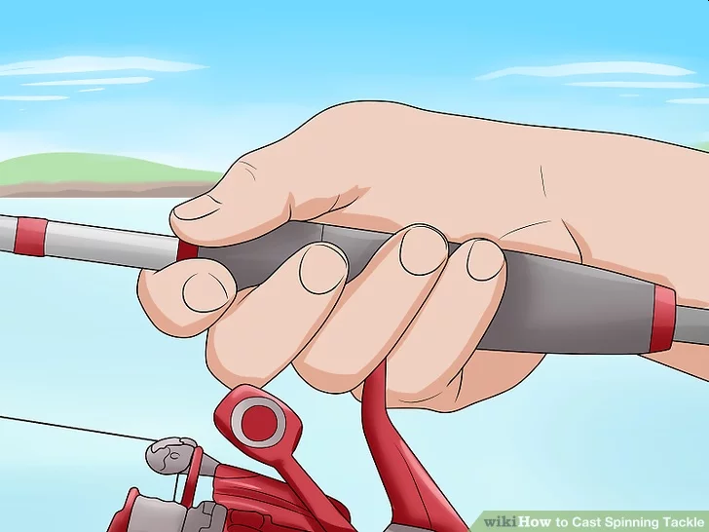
How to Use a Spinning Rod
Hold the rod comfortably in your dominant hand. Hold your arm out perpendicular to the rod with your palm facing inwards. Wrap your fingers around the handle where your reel attaches to your rod. Wrap your pinky and ring finger under the junction with your pointer and index on the other side. Curl your thumb over the top and adjust your grip until it’s comfortable for you.
Don’t squeeze your rod so hard that your knuckles turn white—you need a loose grip to get the proper wrist action when you cast your line.

Slide 50
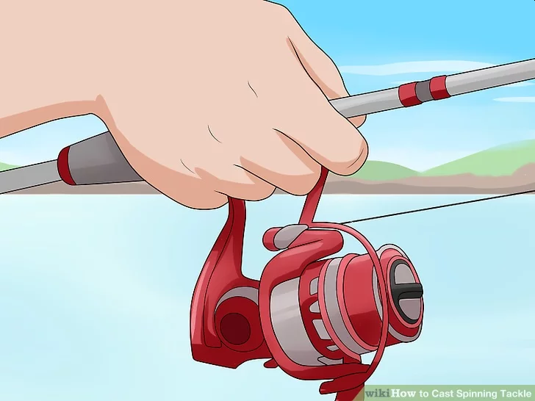
How to Use a Spinning Rod
Rotate your wrist so that the spinning wheel is under the rod. Turn the fishing rod downwards by spinning it in your hand so that the reel mechanism sits directly underneath your wrist. Readjust your grip so that it feels right in your palm.
The spinning wheel is the spherical object attached to the side of your rod above the handle. It contains the fishing line, bail, and reel mechanism.

Slide 51
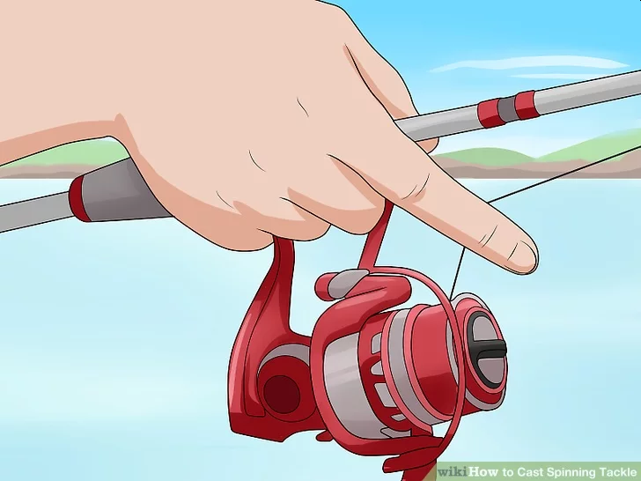
How to Use a Spinning Rod
Stick your index finger out and pull your line in. With your nondominant hand still on the reel handle, release your index finger from under the fishing pole. Point it away from you and hook a section of the fishing line around your knuckle. With the fishing line resting between the pads at the top of your finger, pull it in until you’re holding it against the rod. Release the reel handle if you’re holding it.
Tip: Keep a firm grip on the fishing line to prevent it from unravelling as you choose where you want to throw your tackle.

Slide 52
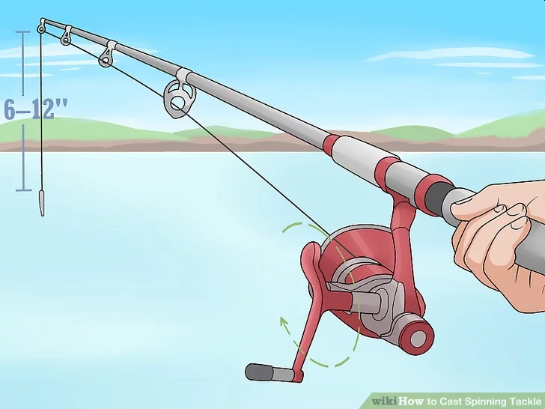
How to Use a Spinning Rod
Reel your line slowly until you have 6–12 inches (15–30 cm) hanging from your rod. Use your nondominant hand to slowly rotate the crank on your reel clockwise. Turn the handle until you have 6–12 inches (15–30 cm) of line hanging from the tip of your fishing rod. If your lure is already at the tip, turn the handle counterclockwise until you have your 6-12 inches.
Lift your index finger a little to release the tension on the line as you do this.

Slide 53
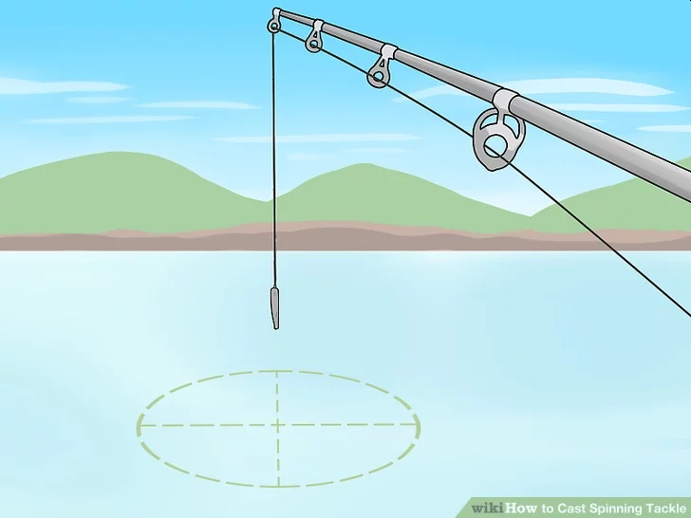
How to Use a Spinning Rod
Identify where you want to throw your line and rotate your body. Once you know where you want to place your lure or bait, line your shoulders up so that you’re square with your target. Put your dominant leg 1–2 feet (30–61 cm) behind you and bend your knees slightly.

Slide 54
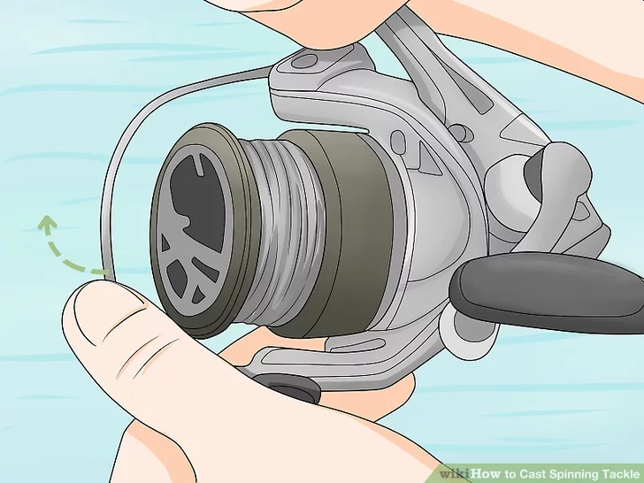
How to Use a Spinning Rod
Flip the bail on your spool to unlock the line. The bail is the thin strip of plastic or metal that connects to opposite sides of your reel. It locks and unlocks your spool to make sure that your line releases properly. Switch your bail’s position so that it’s open, and check to make sure that your reel is unlocked by lifting your index figure off of the line 0.5–1 inch (1.3–2.5 cm) for half of a second to see if the line releases. If it doesn’t, flip it the other way.
If your bail is locked, it could snap your line and send your bait or lure flying into the water.

Slide 55
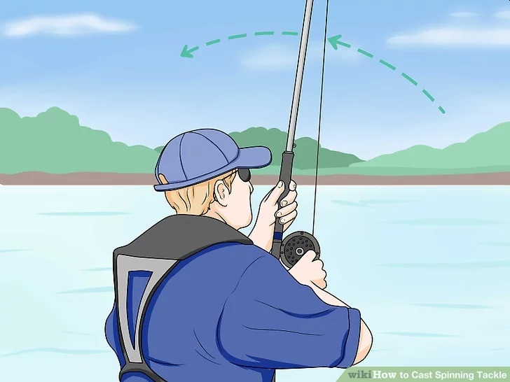
How to Use a Spinning Rod
Raise the rod over your dominant shoulder. Slowly and carefully lift your rod, keeping the end of the fishing pole pointing away from you as you do it. Use your wrist and elbow to raise it and pull the rod directly over your shoulder. Point the rod slightly behind you with your index finger still gripping the line.
Tip: You can choose to keep your nondominant hand on the bottom of your pole to stabilize it if you want, although some fishing enthusiasts prefer to use one hand. Using both hands trades power for greater accuracy.

Slide 56
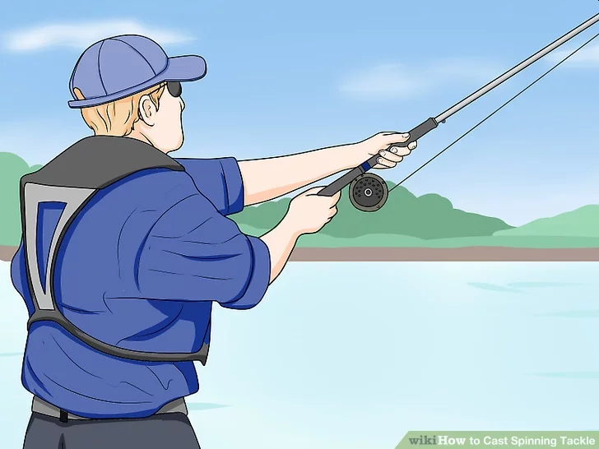
How to Use a Spinning Rod
Throw your rod by propelling your forearm towards your target. Use your elbow as a hinge to propel your wrist in the direction that you want to cast. If you want more distance, drag your bicep down 3–4 inches (7.6–10.2 cm) as you’re doing this to add some additional force. Keep your feet planted firmly on the ground and try to keep your shoulders lined up with your target.

Slide 57
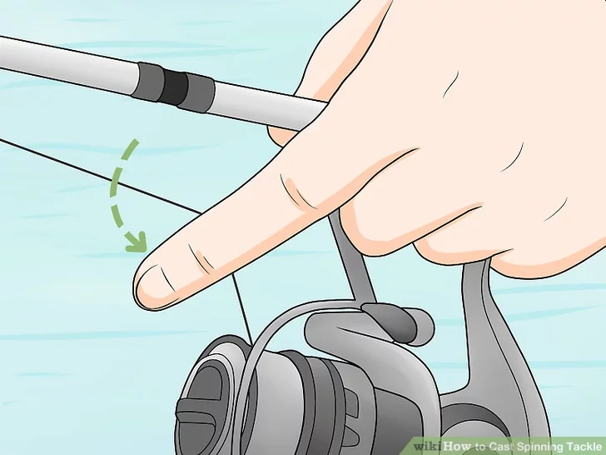
How to Use a Spinning Rod
Release your line by lifting your finger as you cast it. As your forearm begins to move, lift your index off of the fishing line and point it away from your rod. This will relieve the tension on your line and allow the force of your forward motion to propel your rig forward. Slow your arm down and stop your follow through as soon as you see the line flying through the air and you have the rod pointing towards the target.
If your finger is close to the line as you’re casting it, you could scratch or cut yourself from the friction created by the twine as it’s flying away.

Slide 58
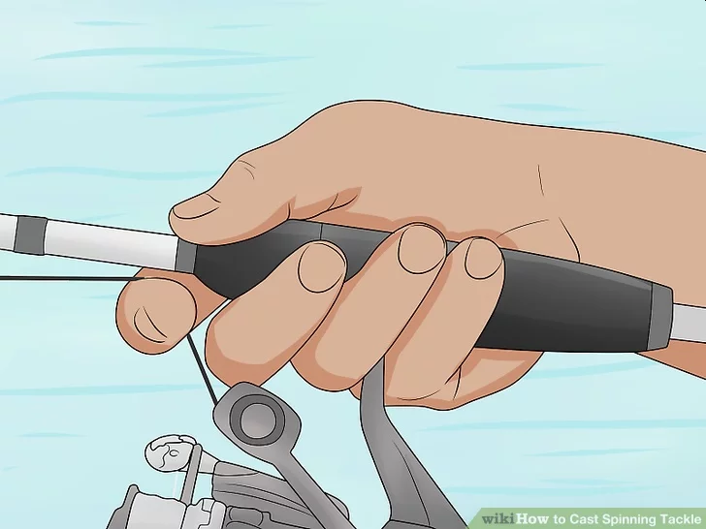
How to Use a Spinning Rod
Grip your line again with your index finger. Once your rig lands in the water, you need to keep it from floating farther away from you. To temporarily hold your line, stick your index finger away from you again and grip the fishing line. Pull it back against your rod and hold it in place.

Slide 59
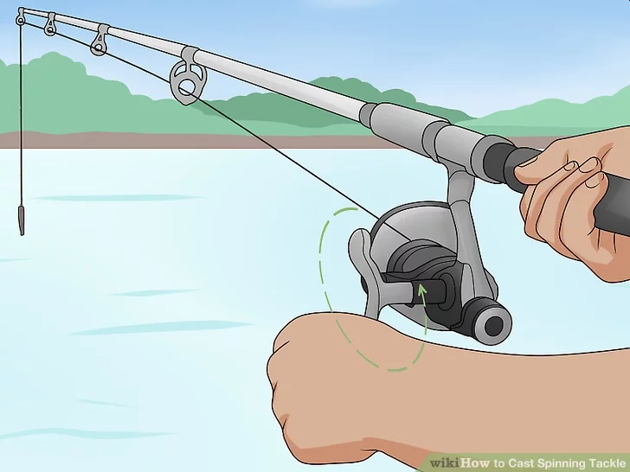
How to Use a Spinning Rod
Rotate the reel handle if you’re unhappy with the location of your lure or bait. If you threw your line out too far or want to try again, you can bring your line in by turning your reel handle clockwise. If you need to, reel it all the way back until you have 6–12 inches (15–30 cm) of line hanging off of your rod and try throwing it again. If you want to loosen the lure and let it out further, rotate the handle counterclockwise. Once you’re happy with the location of your line, you can lock the bail.

Slide 60
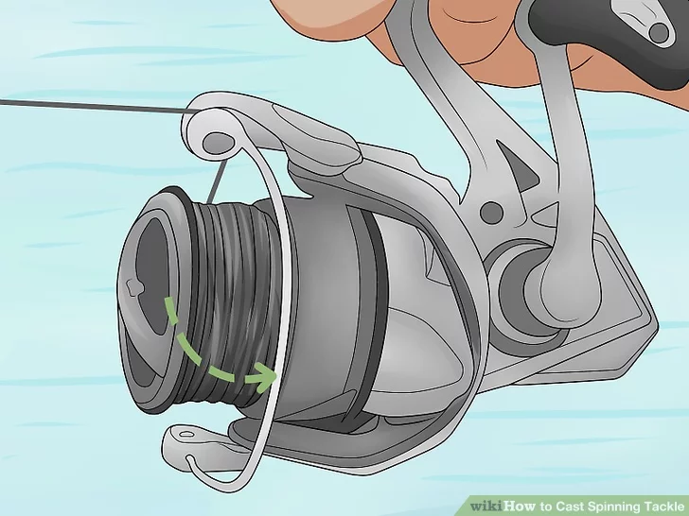
How to Use a Spinning Rod
Flip the bail to the locked position to lock your line. Keep your finger on top of the line near your handle and flip the bail to the locked position with your nondominant hand. To flip the bail, simply pull it to the opposite side where it was originally locked. This will keep your rig from floating away as you wait for a catch.
On most fishing rods, you’ll hear the bail lock with a click.

Slide 61
How to Use a Spinning Rod
Hold your handle firmly and wait for a fish to bite. Once your rig is in a location that you’re happy with, you can move your hand further down the handle. Adjust the line as you deem necessary. All that’s left to do is to enjoy the outdoors and wait for a catch!

Slide 62
How to Use a Casting Rod
The baitcasting reel is placed on top of the rod. This increases power and accuracy, thus enabling you to cast longer distances with a high accuracy.
Since the reel and fishing line is on top of the rod, bigger fish tend to bend the rod down when pulling away. This provides more control when using heavier lures or reeling in bigger fish, like bass and trout.
However, casting reels do require more skill to maneuver it correctly. For this reason, baitcasting rods are used by experienced anglers since they can be hard to control.
These setups don’t do as well with very lightweight lures and baits

Slide 63
How to Use a Casting Rod
Stand facing your intended target area. Square your shoulders and hips with the part of the water where you want your lure or bait to land. Plant both feet firmly side-by-side, with your toes in line with the rest of your body. This will help ensure that your line flies true.
If you prefer, you can stagger your stance so that your dominant-side foot is in the back, since you'll be bring your rod back over your shoulder to initiate the cast. Just make sure your foot positioning doesn't throw off your alignment.

Slide 64
How to Use a Casting Rod
Adjust the reel’s drag and tension. Before taking your baitcasting reel out for the first time, it’s a good idea to adjust the drag and tension settings to a level that’s comfortable for you. You can do this by turning the magnetic wheels on the backside of the rod just above the grip until you get just the right feel. That way, the line will peel effortlessly off the reel when you go to cast.
Baitcasting reels make use of a centrifugal braking system and a tension knob, which creates drag when the line is cast.
If you’ve never cast with a baitcasting rod before, set the resistance wheel to 9. A higher level of resistance will offer greater safety and control for your first few attempts. Once you've gained a little experience, a lower setting will enable you to cast effortlessly and with greater distance.
Baitcasting rods feature a complex design, and it can be easy to throw the settings out of balance if you’re not careful. For this reason, it’s best to have them worked on by a qualified professional.

Slide 65
How to Use a Casting Rod
Reel your lure in 12–15 inches (30–38 cm) from the rod tip. Turn the reel crank clockwise to shorten the line and counterclockwise to lengthen it. Get your bait or lure hanging about 1 ft. (0.30 m) from the end of the rod to ensure maximum leverage and momentum on the cast.

Slide 66
How to Use a Casting Rod
Turn the rod so the reel crank and spool are on top. Positioning the reel mechanisms so that they’re facing upwards will allow you to use your wrist to get a good snap on the cast.

Slide 67
How to Use a Casting Rod
Grip the rod with your thumb resting over the reel spool. Hold your thumb at a slight angle on the outer edge of the spool rather than pressing it flat against the line. This will keep you from accidentally obstructing the spool and give you more control over the flow of the line during the cast.
As with spincasting rods, most fishermen cast and reel baitcasting rods with the same hand. If you decide to perform both actions with the same hand, you’ll need to switch your grip after you cast.

Slide 68
How to Use a Casting Rod
Press the reel spool release button with the thumb of your casting hand. Hitting the spool release button disengages the spool and allows it to turn freely during the cast, making longer casts possible. Once you’ve hit the reel spool release, place your thumb over the exposed spool wheel to keep the spool from unwinding.
On most baitcasting reels, you’ll find a narrow button or bar on the back of the reel handle just below the reel spool that you can quickly find with your thumb.
On older models, the spool release may be located on the outer spool-side edge of the rod instead.

Slide 69
How to Use a Casting Rod
Bring your casting arm up and back toward your shoulder. Raise the tip of the rod off to the side until it's pointing behind you at a slight angle. Crook your bent elbow out beside your face, like you’re about to throw a football.
It’s not necessary to hold your elbow or rod at any precise angle. Just get it into whatever position feels most comfortable to you.
If the tip of your rod dips down to waist level or below, you're probably holding it too low. Try raising it slightly so that it sits at about shoulder height when you go to cast.

Slide 70
How to Use a Casting Rod
Sweep the rod forward while removing your thumb from the spool wheel. Reverse the path of the rod with a quick whip-like motion to initiate the cast. As you take your thumb off the spool, your bait or lure will go zooming in the direction of your target, causing the line to unwind freely. Complete the cast with your rod pointing in front of you in the 10 o’clock position.
Keep your arm relaxed and bent through the movement.
Casting with a baitcaster is more about finesse than force. Instead of trying to throw out your bait or lure, let its own weight carry it forward effortlessly.

Slide 71
How to Use a Casting Rod
Brake the reel spool with your thumb just before it reaches the water. Press your thumb lightly against the spinning spool to “feather” the line, or slow it down smoothly and gradually. Try to make sure it has stopped turning completely before it touches down in your target area.
Another reason most anglers use their dominant hand to cast a baitcasting rod is that it gives them more control over the reel spool wheel.
If you don’t brake your line, it will continue unraveling after your bait hits the water. This can result in a tangle of overrun line (sometimes known as a “bird’s nest”), which you’ll have to straighten out before you can retrieve your lure.
Go ahead and move the rod over to your opposite hand if you want to reel your line in with the same hand you cast with.

Slide 72
Requirement 4
Demonstrate how to tie the following knots: improved clinch knot, Palomar knot, uni knot, uni to uni knot, and arbor knot. Explain how and when each knot is used.

Slide 73
The improved clinch knot is used for securing a fishing line to the fishing lure, but can also affix fishing line to a swivel, clip, or artificial fly. This is a common knot used by anglers because of its simple tie and strong hold.

Slide 74
The Palomar Knot is a simple knot for attaching a line to a hook, or a fly to a leader or tippet. It is regarded as one of the strongest and most reliable fishing knots. The Palomar Knot is recommended for use with braided lines.

Slide 75
The uni knot is a multi purpose fishing knot that can be used for attaching the fishing line to the arbor of a reel, for joining lines, and for attaching lures, snaps, and swivels.

Slide 76
This knot is used by anglers in both salt and fresh water for joining lines of similar or different strengths.

Slide 77
The Arbor Knot is used to attach the fishing line to the “Arbor” or “Spool Center”.

Slide 78
Requirement 5
Name and identify five basic artificial lures and five natural baits and explain how to fish with them. Explain why bait fish are not to be released.

Slide 79
Rattlebaits
The shad-shaped, noise-producing (rattling) Rat-L-Trap crankbait features a combination of sound and action attractive to a variety of predatory fish.

Slide 80
Plastic Worms
Plastic Worms. Made of soft, pliable plastic, these artificial baits can be made to swim, wiggle, and dance underwater with an action fish cannot seem to resist. Four good ways to use plastic worms are worm-and-jig with an artificial night crawler trailing out behind a bare hook; a plastic worm impaled on the hook of a regular bucktail hair jig; a Texas rig, which uses a sliding sinker with the hook stuck through the head of the worm and the point buried back in the worm body; and a plastic worm on a weedless hook with a split shot clipped on the line for casting weight.

Slide 81
Spinnerbaits
Spinners. A spinner is made by hammering a piece of metal very thin, drilling a hole in one end, and mounting it on a strip of wire. The metal blade spins around the wire shaft, glinting like a live minnow swimming in the sunlight.
Spinners may be rigged with hair flies, feather streamers, or live bait.
Sometimes they are used alone with the blade and hook. Most spinners work best if retrieved slowly, just fast enough for the blade to revolve without being a blur.
Spinners are sometimes rigged with jigs for deep fishing. These might have snaps that can be clipped to the eye of the jig.

Slide 82
Jigs
Jigs. Hooks with lead weights molded into the head—called leadheads or jigs—are the basis for a whole range of popular artificial lures. The advantage is in having a single-hook lure that is compact but that can carry enough weight to be easily cast by a bait rod or spin rod. Jigs also are adaptable to a variety of styles that allow them to imitate food that fish recognize. Among the several styles are plastic-bodied grubs impaled on a jig hook; bucktail hair tied to create a weighted streamer fly; weedless bucktail designed for fishing in brush; a “twister”- type plastic body that has a wiggling tail in the water; and a “Canadian” minnow-type jig made with a soft chenille body, feather hackle front and back, and a feather tail.

Slide 83
Jigs
Tips for Using a Jig
Jigs are meant for slow, patient fishermen. Retrieve them especially slow in cold weather or when ice fishing.
Retrieve jigs with “action”—jerks or pulls imparting a swimming motion.
When a fish strikes a jig, it may be detected as only a twitch in the line. Be aware, and set the hook immediately.
Fish with the lightest jig that allows you to feel when the jig is on the bottom.
Be sure to keep jig hooks sharp so they are not easily dislodged.

Slide 84
Minnowbaits (Plugs)
Plugs. The first plugs—minnowlike replicas—were carved out of wood. Some still are, but most are made of plastic by lure manufacturers.
Floating-diving plugs rest on the surface until reeled in. They are designed to wiggle in the water like a minnow.
Some plugs are made to run deep. These may be either all metal or weighted with metal and plastic. Some have a long bill in the front that causes them to head for the bottom when reeled in. They also are effective lures when trolled behind a boat.
Surface plugs are made to imitate either a frog hopping across the top of the water or a large, injured minnow that is flopping around in distress. Bass, pike, and muskellunge are species most often caught on these gurgling, popping, and sputtering lures.

Slide 85
Spoons
Spoons. When fishermen noticed that minnows and certain other aquatic creatures glistened in the sunlight, the idea of making lures out of shiny metal was born. Spoons are made by cutting pieces of metal to shape, hammering them out so that they wobble in the water, and polishing them to a high shine. Various colors of enamel are added to some; others are given gold or silver finishes. They are called spoons because most of them are shaped like the lower part of a teaspoon.

Slide 86
Freshwater Natural Baits
Worms. Red worms, garden worms, and night crawlers all are good baits. A small hook (size 8 to 12) embedded in the head of a worm works well.
Minnows. Anglers use dozens of minnow varieties as bait. One common method is to hook the minnow through both lips, from the bottom up. Another is to put the hook through the body near the tail.

Slide 87
Freshwater Natural Baits
Crayfish. As crayfish grow, they shed their hard outer coat several times in the summer. When in the “soft” state they make an excellent game fish bait.
Leeches. The ribbon leech (Nephelopsis obscura) is an excellent bait. Most fish will reject bloodsucking leeches.

Slide 88
Freshwater Natural Baits
Hellgrammites. These larvae of the dobsonfly are found under rocks in riffles. They are excellent bait but must be kept off the bottom or they will snag the hook.

Slide 89
Saltwater Natural Baits
Eels. These are a common bait along the East Coast, particularly for striped bass and bluefish. Anglers often place eels on a double-hook rig, usually with a weighted hook in the head.
Crabs. Several species are used as bait, the fiddler crab being the most common. The larger claw is pulled off and the hook embedded in the crab at that point.

Slide 90
Saltwater Natural Baits
Sandworms. Along with bloodworms, sandworms are a popular bait. For large fish, the whole worm is hooked on. For smaller fish, the worm may be cut up and just a piece used.
Shrimp. Used whole or with just the tails on the hook, shrimp are excellent for a wide variety of fish. A piece of shrimp on a jig is highly effective.

Slide 91
Saltwater Natural Baits
Squid. Cut into strips, squid will take many species of saltwater fish. Other cut bait such as mullet or menhaden are used for weakfish, bluefish, channel bass, and striped bass.
Killifish. This popular bait for bottom species is fished live, hooked through the nose. Killies are tough and durable if given reasonable care.
Clams. These come in many sizes. Small clam meats are used whole; large ones may be cut up. Clam meats are obtained by pushing a knife between the shells and severing the muscles.

Slide 92
Release of Baitfish
Biologists recognize “bait bucket introductions” as one of the most common means of spreading aquatic invaders and diseases.
Bait bucket introductions occur when anglers dump live bait into a water body from which that bait did not originate.
This practice has caused the spread of some of the most notorious invaders, including rusty crayfish and round goby, and even zebra mussels.
These non-native invaders disrupt food chains and harm ecosystems and damage sport-fishing opportunities as well as bring diseases that native species are not equipped to cope with.
The solution to bait bucket introductions is simple. Anglers shouldn’t dump their leftover bait in the water at the end of a fishing trip.

Slide 93
Requirement 6
Do the following:
Explain the importance of practicing Leave No Trace techniques. Discuss the positive effects of Leave No Trace on fishing resources.
Discuss the meaning and importance of catch and release. Describe how to properly release a fish safely to the water.

Slide 94
Leave No Trace
To ensure a healthy future for ourselves and our environment, we must do more than simply pick up litter. We must learn how to maintain the integrity and character of the outdoors.
Plan Ahead and Prepare. Proper planning and preparation for a fishing trip helps ensure a safe and enjoyable experience while minimizing damage to natural and cultural resources. Anglers who plan ahead can avoid unexpected situations and minimize their impact by complying with area game and fish laws, such as size and catch limits, tackle and bait regulations, and seasonal restrictions. Failure to know and obey these laws can lead to an arrest and a fine. Be sure to obtain a fishing license if necessary and any other needed permits or permission before heading out on your fishing adventure.

Slide 95
Leave No Trace
Travel and Camp on Durable Surfaces. Whether you fish for a few hours or an entire day, or you plan to camp and fish, it is important to minimize your impact on the land. Damage to land occurs when visitors trample vegetation or communities of organisms beyond recovery. The resulting barren areas develop into undesirable trails, campsites, and fishing spots and cause soil to erode. If fishing from shore in high-use areas, concentrate activity where vegetation is already absent. Minimize resource damage by using existing trails and selecting designated or existing fishing areas. If camping overnight, always camp at least 200 feet from shorelines. It is especially important to avoid impacting stream banks and lakesides.

Slide 96
Leave No Trace
Dispose of Waste Properly. Pack it in; pack it out. This simple yet effective saying motivates outdoor visitors to take their trash home with them. Inspect your fishing spot, boat, or campsite for trash or spilled foods. Accept the challenge of packing out all trash, leftover food or bait, and used or broken fishing line. Use designated fish cleaning areas or check with the local game and fish officials if you will be fishing in a more remote area. You must properly dispose of any fish entrails or bodily waste in solid waste facilities or by burying them in a cathole. A cathole should be dug 6 to 8 inches deep in humus soil and should be at least 200 feet from water, trails, and campsites. If cooking in the backcountry, strain food particles from the dishwater and disperse the wastewater at least 200 feet from springs, streams, and lakes. Pack out the strained food particles. Use biodegradable soap 200 feet or more from any water source.

Slide 97
Leave No Trace
Leave What You Find. Allow others a sense of discovery, and preserve the past. Leave rocks, plants, animals, archaeological artifacts, and other objects as you find them. Examine but do not touch cultural or historical structures and artifacts that you may stumble across. It may be illegal to remove artifacts. Good fishing spots are found, not made. Avoid altering a site, digging trenches, or building structures. Never hammer nails into trees, hack at trees with hatchets or saws, or damage bark and roots by tying horses to trees for extended periods. Replace surface rocks or twigs that have been cleared from the fishing spot or campsite. On high-impact sites, clean the area and dismantle inappropriate user-built facilities such as log seats or tables and multiple fire rings.

Slide 98
Leave No Trace
Minimize Campfire Impacts. If you plan to cook what you catch while on a fishing trip, consider the potential for resource damage. Some people would not think of cooking or camping in the outdoors without a campfire. Yet the naturalness of many areas has been degraded by overuse of fires and increasing demand for firewood. A low-impact alternative is to use a lightweight camp stove. Stoves are fast, eliminate the need for firewood, and make cleanup after meals easier.

Slide 99
Leave No Trace
Respect Wildlife. Help keep wildlife wild. While fishing, chances are you will encounter other wildlife as well, on the shore or in the water. Avoid disturbing animals by observing them from afar and giving them a wide berth. You are too close if an animal alters its normal activities. Never feed wildlife (except the fish you’re trying to catch, of course!). Store food and garbage securely to avoid attracting wildlife. Be respectful of any catch-and-release areas, and return unharmed to the water any fish that you do not plan to eat or that exceed the designated limit.

Slide 100
Leave No Trace
Be Considerate of Other Visitors. Thoughtful anglers respect other visitors and protect the quality of their experience. The following are a few tenets of outdoor ethics:
Travel in small groups. If camping, do so in groups no larger than that prescribed by the land managers.
Let nature’s sounds prevail. Keep the noise down and leave radios, music players, and pets at home. Fish can be spooked by such interruptions. In bear country, however, being a bit talkative on the trail might help prevent a surprise encounter with a bear.
Select fishing spots and campsites away from other groups to help preserve their solitude and their chances of catching fish.
Always travel quietly to avoid disturbing other visitors. If fishing from a watercraft, take care not to disturb other anglers’ efforts on the water.
Respect private property and leave gates (open or closed) as found.

Slide 101
Catch and Release
Catch and release helps prevent overfishing.
Use artificial lures with barbless single hooks. Fish tend to swallow live bait more deeply, and barbless hooks are easier to remove and do less damage than barbed hooks.
Play the fish, then release it as gently and quickly as possible. Do not play the fish to exhaustion, or it may not recover.
If the fish has swallowed the hook, cut off the line as close to the hook as possible. Never try to remove a deeply embedded hook because you may damage the fish beyond recovery or make it a more vulnerable prey.
Avoid stainless steel hooks. If swallowed, they will not dissolve over time.
Whenever possible, avoid removing the fish from the water. Prepare your camera for pictures first; hold up the fish for a quick photo, and release it immediately.
If you must use a landing net, make sure it is made of soft nylon and not hard mesh, which can damage the slime that covers the fish and helps protect it from disease.
If you must handle the fish, wet your hands first. Support the fish horizontally—never vertically—in the water across the back and head, avoiding the eyes and gills. Before releasing, revive the fish gently by moving it back and forth in the water until it swims away.

Slide 102
Requirement 7
Obtain and review a copy of the regulations affecting game fishing where you live. Explain why they were adopted and what you accomplish by following them.

Slide 103
Requirement 7
Ohio Fishing Regulations 2020-21

Slide 104
Why Do We Have Fishing Regulations?
There are good reasons for fishing laws. All are intended to conserve and improve fish populations. Fisheries biologists study bodies of water to check on fish numbers and the health of fish populations. If there is a problem with a fish stock, regulations are created to help keep the fish population healthy. Marine Patrol officers check to make sure that fishing regulations are being obeyed.

Slide 105
Why Do We Have Fishing Regulations?
There are several types of fishing regulations. Limits on the number of fish that can be caught are meant to keep anglers from taking too many fish at one time. Size limits are meant to protect fish of spawning size before they are caught. Fishing seasons protect fish during spawning and limit the catch on heavily fished waters. Fishing laws are meant to protect fish and make sure there is fishing to be shared by everyone.
If you fish, it's important that you know the rules and regulations. Ignorance of the law is no excuse. Fishing is a wonderful privilege; obeying fishing regulations is the responsibility that goes with it.

Slide 106
Requirement 8
Explain what good outdoor sportsmanlike behavior is and how it relates to anglers. Tell how the Outdoor Code of the Boy Scouts of America relates to a fishing sports enthusiast, including the aspects of littering, trespassing, courteous behavior, and obeying fishing regulations.

Slide 107
Requirement 8
BSA’s Outdoor Code helps stimulate awareness by Scouts of the need for every user of the outdoors to be a responsible patron of outdoor resources.
As an American, I will do my best to—Be Clean in my Outdoor Manners.
I will treat the outdoors as a heritage. I will take care of it for myself and others. I will keep my trash and garbage out of lakes, streams, fields, woods, and roadways.
Be Careful With Fire.
I will prevent wildfire. I will build my fires only when and where they are permitted and appropriate. When I have finished using a fire, I will make sure it is cold out. I will leave a clean fire ring, or remove all evidence of my fire.
Be Considerate in the Outdoors.
I will treat public and private property with respect. I will follow the principles of Leave No Trace for all outdoor activities.
Be Conservation-Minded.
I will learn how to practice good conservation of soil, waters, forests, minerals, grasslands, wildlife, and energy. I will urge others to do the same.

Slide 108
Requirement 9
Catch at least one fish and identify it.

Slide 110
Requirement 10
If regulations and health concerns permit, clean and cook a fish you have caught. Otherwise, acquire a fish and cook it. (You do not need to eat your fish.)

Slide 111
Cleaning a Fish

Slide 112
Get a plastic bag or bucket and lay out newspaper to keep clean. You’ll use the bag or bucket for guts and bones. Get your disposal system ready before you start cutting so you can toss the guts and excess fish without getting up. Newsprint laid out on the cutting surface is helpful for soaking up the inevitable liquids that will spill out of the fish.

Slide 113
Use a dull knife or spoon to remove the scales. While a knife or spoon will work, a more effective option is to screw a bottle cap onto a wooden handle and use the cap to remove the scales. Work against the normal direction of the scales, raking up from tail to head. Think of a short, shallow, scoop motion, getting under the scales and pushing up and into them quickly to rake them out of the fish. Get both sides, the top, and bottom of the fish.
It can help to scale under running water, or simply underwater in the sink, to prevent a mess.
Don't worry if you miss a few scales—they aren't tasty, but they won't hurt anyone.

Slide 114
Skin thick-skinned fish instead of removing the scales. If you’re cleaning a bullhead (also known as a Sculpin), catfish, or another thick-skinned bottom feeder, consider skinning it. To do so, cut a 1 inch (2.5 cm) notch right where the top of the fish's head meets its body. Then, gripping the fish from the head, peel the skin back to the tail. Rinse the flesh thoroughly when you’re done.
These fish, in particular, have a thick, unappealing skin that most people remove before cooking.

Slide 115
Cut a shallow incision from the anus up towards the head. The small hole on the belly of the fish, back near the tail, is the anus. Using a sharp knife, make a shallow cut from here along the belly of the fish, stopping at the base of the gills.
Don't jam the knife in their, or you'll cut the intestines open. You want a shallow cut so that you can pull them out intact, preventing messy (and unappetizing) spillage.

Slide 116
Use your fingers or a dull spoon to scoop out the fish's innards. Get in there and get everything out. These gummy, long guts should come out without much of a fight. Make sure to check inside to get out anything you missed, like the large, dark kidney in the back or some strands of innards along the walls.

Slide 117
Scrape out any dark, inner membrane if found. Not all fish have this thin layer in their inner cavity, but you want to remove it if they do. This is strongly flavored and has an oily, extra-fishy aroma that you don't want in your final dish.

Slide 118
Cut off the head off directly behind the gills, if desired. You do not have to cut the head off, and depending on your cooking method you might not want to, as the head adds flavor and depth. The "cheek meat" of the fish, as well, is considered the best part in some cultures.

Slide 119
Remove a dorsal fin by pulling firmly from tail to head. This, like the head, does not have to come off if you don't want to remove it, but it will help remove many nasty little bones. Simply grip the fin tightly near the tail, and pull quickly in the direction of the head to rip it out cleanly or use scissors to cut it off.

Slide 120
Rinse the fish off, inside and out, in cool water. Make sure you wash the outside, getting rid of any sticky scales, as well as the inside, getting rid of bits and blood. Your fish is now ready to cook! Use as little water as possible to preserve the flavor of the fish. Some people prefer to gently wipe off the fish with a paper towel instead of rinsing it.

Slide 121
Filleting a Fish

Slide 122
Cut just behind the top of the head until you hit the backbone. To do this, lay the fish on one side. Take care not to cut through the spine, just to it.

Slide 123
Continue this cut in an arc around the fish's head. Again, you don't want to cut deeper than the backbone. You will not be cutting the head off, just cutting about halfway into the fish.

Slide 124
Turn the knife and cut horizontally towards the tail, through the center of the fish. You'll basically be cutting off the entire side of the fish, removing the whole flank, skin and all. The knife will travel perpendicularly to the backbone, which you can use as a guide to ensure a nice, flat cut.

Slide 125
Flip the fish and repeat on the opposite side. Simply repeat the same process on the other half of the fish, removing the other fillet.

Slide 126
Lift and remove the rib cage from the inside of the fillet. Using a smaller knife to remove the rib cage. This will be the small, almost translucent set of bones on the lower third of fish fillet. It should come off in one piece.

Slide 127
Cut directly through the fish perpendicularly to form steaks as an alternative. If you don’t want fillets, you can cut steaks. Use a sharp knife and cut perpendicular to the backbone, going all the way through the spine to get 1 inch (2.5 cm) steaks. This is common with bigger fish, like trout and salmon, and retains the spine running through the middle of the fish.

Slide 128
Scale the fish or remove the skin entirely, if desired If you want to cook the fish with the skin still on, use the dull side of a knife to rake the scales off. Use a short, lifting motion from the tail to the head to quickly scrape all of the scales off. If you don't want the skin, simply slide the knife between the fish and the skin and simply cut the skin away.

Slide 129
Cooking a Fish

Slide 130
Cooking a Fish
Grilling.
With your coals or gas grill, you'll want to try to make a hot pile and a cold pile, so that you can cook the fish over low heat for the majority of the time, and then give it some color by finishing the cooking over high heat at the very end. Be sure to use the thermometer to get the temperature correct, and remember that fish cooks extremely quickly! When grilling fish, be sure to oil the grill and the fish generously before cooking. A well-oiled fish and grill will keep the fish from sticking to the grate when you choose to flip it. If you want to, you can also use an aluminum foil pouch to keep the fish in as it cooks; this saves cleanup time and cooks the fish very nicely.
Remember to choose the right kind of fish for grilling. Meaty, hearty fish like salmon, halibut, and swordfish work best on the grill, especially if you can get them cut into steaks. Delicate white fish like cod, flounder, or sole tend to fall apart easier on the grill, making for a less than ideal marriage between grill and fish.

Slide 131
Cooking a Fish
Baking
Probably the healthiest cooking option available, baking relies on dry heat and less oil to thoroughly bring the fish to perfection. Line a baking tray with wax paper or aluminum foil, thoroughly oil the fish (or paint with a dab of melted butter), and cook at a lower heat for a longer time. Here's some more specific pointers for you to remember as you bake fish: If you're baking with a fish fillet that has a thicker center and thin sides, curl the thin sides underneath the fish as it cooks. That way, the sides won't be overcooked be the time the rest of the center is done.
Because fish are delicate and dry out easily, bake fish at low temperatures (250° F) for longer periods (20 minutes for fillets). For thicker (center cut) fish, many chefs recommend cooking at higher temperatures (400°F) for less time (15 minutes), although cooking times depend on the thickness of the cut.

Slide 132
Cooking a Fish
Baking (continued)
The 10-minute rule for baking fish. Measure the cut of fish at its thickest point. For every inch of thickness, cook for 10 minutes at 400° - 450°F. Pro-rate the ratio for uneven thicknesses. For example, a 1.5 inch center cut piece of salmon should be cooked for 15 minutes at around 425° F.
For added flavor and moisture, think about adding herbs and aromatics to your baked fish. Lemon and capers or dill works great with salmon as well as with other types of fish. Bread crumbs work well with white fish, particularly tilapia.

Slide 133
Cooking a Fish
Pan-frying.
Start off with enough oil and a hot pan. Oil your steel pan generously but not excessively and get it hot. Starting off hot helps cook the skin on the fish quickly, allowing it to adhere to the meat of the fish for nice presentation and an even nicer feel in the mouth.
Always pan-fry with skin side down to begin with. That way, your skin browns evenly and adheres to the meat of the fish.
After a minute or two on medium or high heat, turn the heat down to medium-low or low. Cook the fish slowly from here on out. Cook too hot and the moisture will evaporate from the fish before it's fully cooked, leading to a drier fish.
Flip once! Start off cooking the fish skin side down at high temperature. Turn the temp down significantly, and continue cooking for a little bit. Flip the fish once, and only once. Continue cooking the fish until you can easily cut and flake the meat with a fork.

Slide 134
Cooking a Fish
Deep-fried fish.
Fish are usually battered and then dunked into a hot pan filled with oil. Here are some basics for you to remember as you fry fish: Decide on dredge vs. batter. You can dredge your fish in flour and egg, making for a lighter fish, or whip up a batter out of beer or buttermilk for a thicker, crunchier shell. Cooking times do not vary significantly for either method.
You'll most likely want your oil to be at around 375ºF when you start frying, and cook the fillets for about 3 to 4 minutes, or until golden brown.

